Slide 1
Training for Medical Education via Innovative eTechnology
MediTec
Dr. Mohammad Sadegh Ghasemi Vice-Chancellor for International Affairs
Iran University of Medical Sciences (IUMS), Tehran, Iran Email : ivco@iums.ac.ir

Slide 2
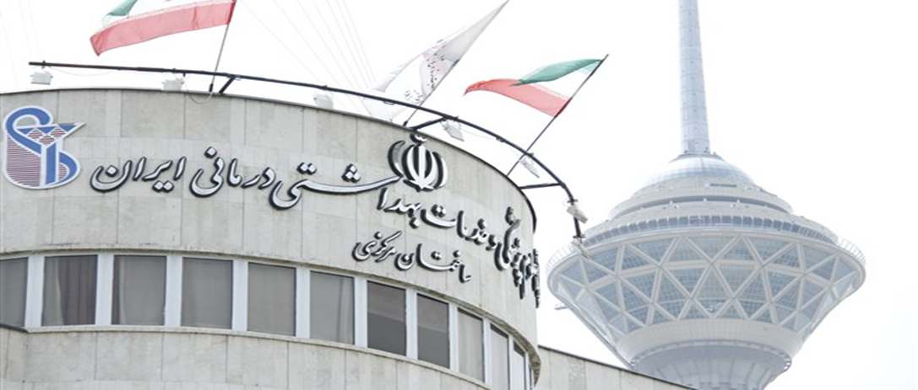

Slide 3
Iran University of Medical Sciences (IUMS) was established as a Medical Centre in 1974. It started by gathering several thousand scientific journals and books in different branches of medical sciences to establish a library. Because of its direct communication with the American Medical Information Centre, it was considered one of the most important medical centers at international level. Activities commenced in 1976 with Iran Shahr Clinic (Shahid Rahnemon Hospital), the only affiliated hospital in the country. Thereafter, the School of Nursing and Allied Medicine was established at the undergraduate and graduate levels. The center officially became the Iran University of Medical Sciences in 1986.
40 years of excellence in education, research and patient care

Slide 4
IUMS Schools
IUMS Schools: Established
School of Medicine: 1975
School of Allied Medical Sciences: 1986
School of Nursing & Midwifery: 1986
School of Public Health: 1987
School of Rehabilitation: 1973
School of Health Management & Information Sciences: 1973
School of Behavioral Sciences & Mental Health: 1986
School of Advanced Technologies in Medicine: 1993
School of Traditional Medicine: 2006
School of International Pharmacy 2015
School of International Dentistry (New Degree) 2017

Slide 5
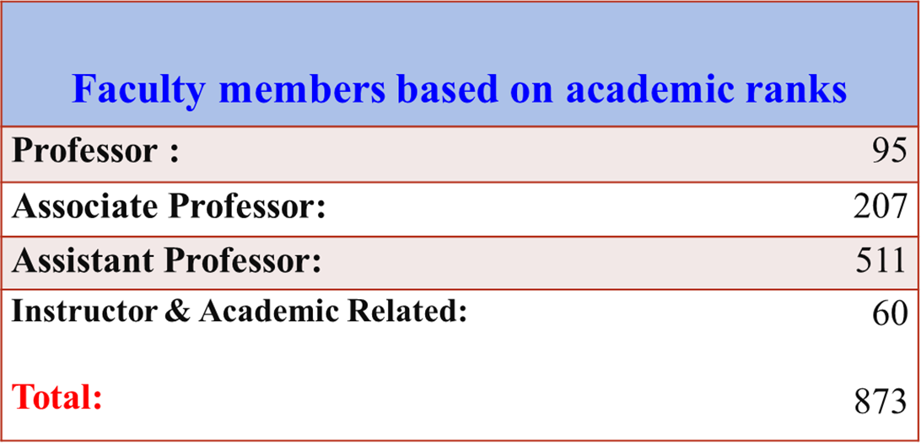

Slide 6
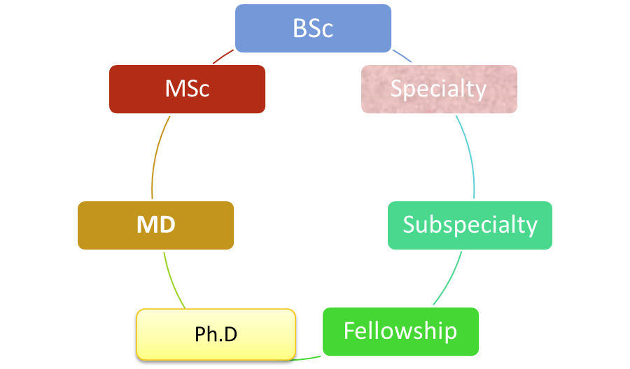
IUMS Academic Degrees and Student
9500 students study in 98 different Departments

Slide 7
Institutes & Research Centers
Institutes
Islamic and Complementary Medicine and Research Center;
Endocrinology and Metabolism Research and Training Center;
Immunology.
47 Raised Research Center
Nursing Care Research Center
Physiology Research Center
Immunology ‎Research Center
Anti- Microbial Resistance
Occupational Medicine
Mental Health
Rehabilitation
Burn
Health Management and Economics
Cardiovascular
Drug
Pediatric Diseases
Bone and Joint and ……

Slide 8
Public Urban Health Centers
Quds ;
Malard;
Shahriar;
Baharestan;
Robat Karim;
West of Tehran;
North – West of Tehran.
IUMS Providing Health Services to more than 5.3 Million People in Tehran.

Slide 9
10 Teaching hospital and 15 non-teaching hospitals in Tehran
Hazrat Rasool Akram (s) General Hospital
Shahid Rajaie Cardiovascular, Medical & Research Center
Firoozgar General Hospital
Hazrat Ali Asghar Hospital
Shahid Hashemi Nejad Urology Hospital
Shahid Motahari Burns Hospital
Shafa Yahyaeian Orthopedics Hospital
Hazrat -e Fatemeh Plastic Hospital
Shahid Akbar Abadi Hospital
Iran Psychiatric Hospital

Slide 10
Hazrat Rasool Akram (s) Hospital operates 75 clinics with a daily admission of 500 patients.
32 Wards:
700 Inpatient Bed;
17 Ancillary service departments;
1200 Personnel .
Hospital’s research center
Laparoscopic Surgery,
Ophthalmology Surgery,
Otolaryngology Surgery,
Minimal invasive surgery,
ENT Surgery,
Laser Surgery,
Pediatric Infectious Diseases,
Pulmonology

Slide 11
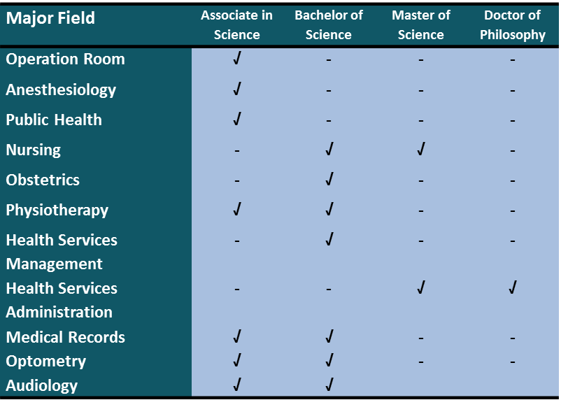
Paramedical Practical Training Programs

Slide 12
Departments | Teaching and Training Programs
 | Stagers | Internship | Residency | Fellowship | Subspecialty
Internal Medicine
General | √ | √ | √ | - | -
Cardiology | √ | √ | √ | - | -
Endocrinology | √ | √ | √ | - | -
Rheumatology | √ | √ | √ | - | √
Hematology & Oncology | √ | √ | √ | - | -
Gastroenterology | √ | √ | √ | - | √
Pulmonology | √ | √ | √ | - | √
Nephrology | √ | √ | √ | - | -
Neurology | √ | √ | √ | - | -
Infectious Diseases | √ | √ | - | - | -
Pediatrics
General | √ | √ | √ | - | -
Endocrinology | √ | √ | √ | - | -
Hematology & Oncology | √ | √ | √ | - | -
Gastroenterology | √ | √ | √ | - | -
Nephrology | √ | √ | √ | - | -
Neurology | √ | √ | √ | - | -
Immunology & Allergy | √ | √ | √ | - | √
Neonatology | √ | √ | √ | - | -
Infectious Diseases | √ | √ | √ | - | √

Slide 13
Medical Teaching and Training
Departments | Teaching and Training Programs
 | Stagers | Internship | Residency | Fellowship | Subspecialty
Surgry General | √ | √ | √ | - | -
Head & Neck | √ | √ | √ | - | -
Thorax | √ | √ | √ | - | -
Vascular | - | - | √ | √ | -
Colorectal | - | - | √ | √ | -
Laparoscopy | - | - | √ | √ | -
Urology | √ | - | - | - | -
Orthopedics
General | √ | √ | √ | - | -
Spine | - | - | √ | √ | -
Knee | - | - | √ | - | -
Pelvis | - | - | √ | - | -
Leg | - | - | √ | - | -
Hand | - | - | √ | - | -
Neurosurgery
General | - | - | √ | - | -
Stereotactic | - | - | √ | - | -
Deep Brain Stimulation (DBS) | - | - | √ | - | -

Slide 14
Departments | Teaching and Training Programs
 | Stagers | Internship | Residency | Fellowship | Subspecialty
Ophtalmology General | √ | √ | √ | - | -
Cornea | - | - | √ | √ | -
Retina | - | - | √ | √ | -
Strabismus | - | - | √ | √ | -
Oculoplasty | - | - | √ | √ | -
Neuroophthalmology | - | - | √ | - | -
ENT
General | √ | √ | √ | - | -
Otology | - | - | √ | √ | -
Rhinology | - | - | √ | √ | -
Laryngology | - | - | √ | √ | -
Cochlear Implants | - | - | √ | - | -
Basal Skull Endoscopy | - | - | √ | - | -
Dermatology | √ | √ | √ | - | -
Psychology | √ | √ | √ | - | -
Gynecology & Obstetrics | √ | √ | √ | - | -
Emergency | √ | √ | √ | - | -
Anesthesiology
General | - | - | √ | - | -
Pain | - | - | √ | √ | -
ICU | - | - | √ | √ | -
Medical Teaching and Training

Slide 15
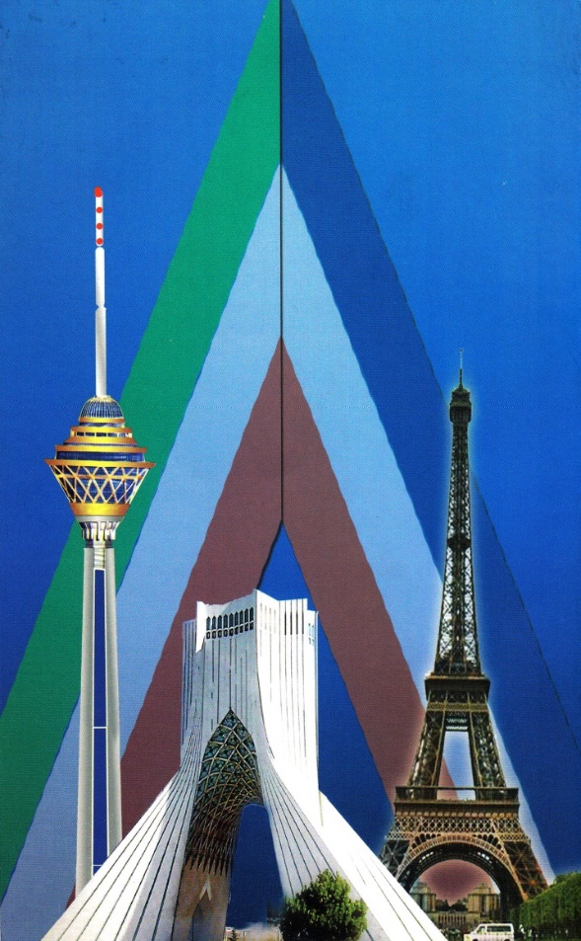
Partnership, Membership and Educational Cooperation
University of Santiago de Compostela
University of Minho
University of Staffordshire
University of Almería
University of Nantes
Technical University of Berlin
University of Almería
University of Cagliari
University of Halabja
University of Raparin
University of Nicosia
Vienna Ludwig institute
Sapienza" University of Rome
University of Ankara
University of Gazi
University of Hacettepe
AP-HP, Greater Paris University Hospitals and …….

Slide 16
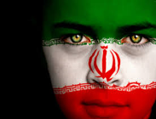
Thank You For Your Attentions
http://iums.ac.ir/

